Slide 1
Digital Signatures
Digital Signatures are used to “Sign” messages to validate the source and integrity of the contents.
AC10F1AB38

Slide 2
What is a digital signature?
A digital signature is a kind of ID. You can use it on the Internet to identify yourself in a secure manner. This is extremely useful in areas such as electronic commerce. For instance, when making a credit card purchase on the Internet, you can use your digital signature to "sign" that purchase. This helps to ensure that only you can make purchases with your credit card number.

Slide 3
What is a digital signature?
A digital signature is a mathematical scheme for verifying the authenticity of digital messages or documents. A digital signature serves three purposes:
Authentication: A digital signature gives a recipient reason to believe that the message was created by a known sender.

Slide 4
What is a digital signature?
Non-repudiation: With digital signature, signer cannot successfully claim he/she did not sign a message.
Integrity: A digital signature ensures that the message was not altered in transit.

Slide 5
Requirements for a Digital Signature
The signature must be a bit pattern that depends on the message being signed
The signature must use some information unique to the sender, to prevent both forgery and denial.
It must be relatively easy to produce digital signature.
It must be relatively easy to recognize and verify the digital signature.
It must be computationally infeasible to forge a digital signature.

Slide 6
How is a Digital Signature Produced?
Very briefly, a typical digital signature works like this:
  A signature in the form of a code is generated by applying an algorithm and the sender's private key to message contents.
  The recipient verifies the signature by decrypting it using the sender's public key.

Slide 7
The Idea
Goal - guarantee that message must have originated with certain entity
Idea - encrypt with private key, decrypt with public key
Only owner of the private key could have generated original message

Slide 8
Steps in making a digital signature
Joe runs a one-way hash function to create a fixed length message digest from the message to be sent
Joe encrypts the message digest with his private key to create a digital signature.
Joe sends the signature and the message to Alice
Alice decrypts the signature with Joe’s public key to reveal the message digest
Alice then applies the same one-way function to the message she received from Joe to produce a message digest
Alice compares the message digest she created with the message digest sent by Joe. If they compare the integrity of the messages is verified.

Slide 9
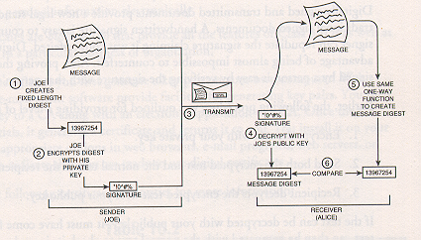
Steps in making a digital signature

Slide 10
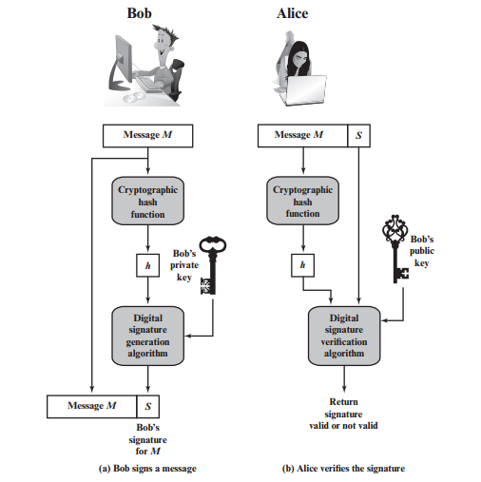
Steps in making a digital signature

Slide 11
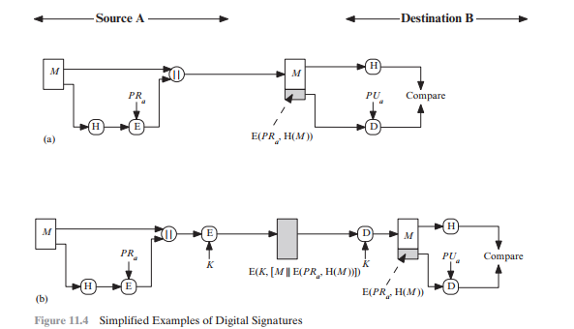
Digital Signature
Figure 11.4 illustrates, in a simplified fashion, how a hash code is used to provide a digital signature.

Slide 12
Digital Signature
a. The hash code is encrypted, using public-key encryption with the sender’s private key. This provides authentication. It also provides a digital signature, because only the sender could have produced the encrypted hash code. In fact, this is the essence of the digital signature technique.
b. If confidentiality as well as a digital signature is desired, then the message plus the private-key-encrypted hash code can be encrypted using a symmetric secret key. This is a common technique.

